Slide 1
GROUP 2

Slide 2
Group Members
Name
Mohammed Asik K.
Jabbar M.A
Ajaykumar Yadav
Bhavya Shree
Priyal Potnis*
Divya Sri Thota

Slide 3
HARDWARE FUNDAMENTALS

Slide 4

Computer
It is an electronic device which takes the data, process the data according to the instructions and provides the output to the user.
Hardware:
Physical parts of the computer.
Eg: I/O devices, motherboard..
Software:
Set of instructions given to the computer.

Slide 5
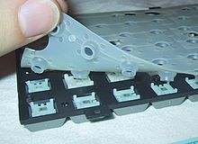
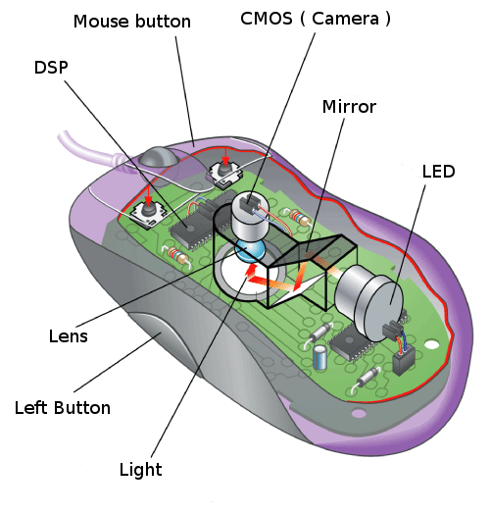
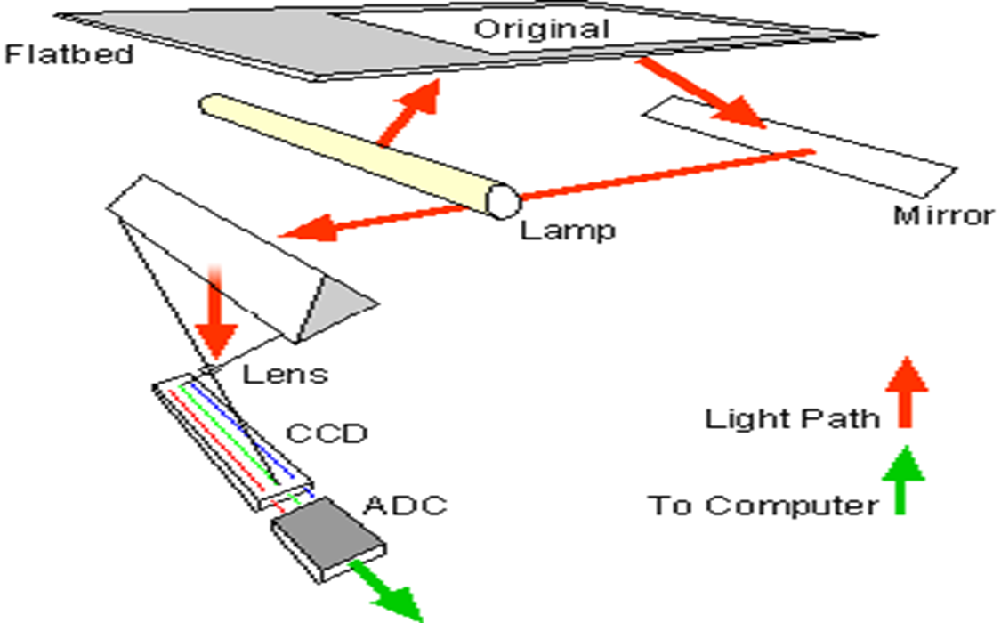

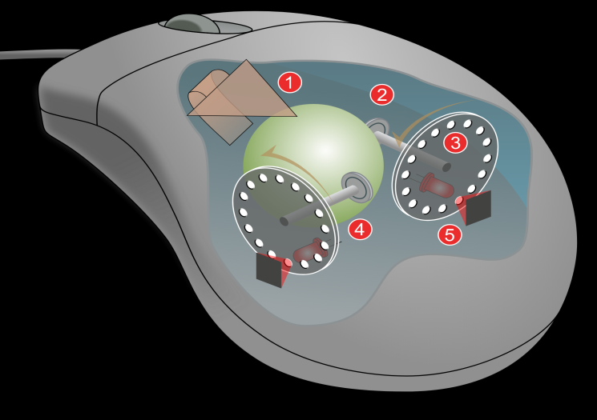
Input Devices
An input device is any hardware device that sends data to a computer
MEMBRANE KEYBOARD
OPTICAL MOUSE
SCANNER
MECHANICAL KEYBOARD
MECHANICAL MOUSE

Slide 6
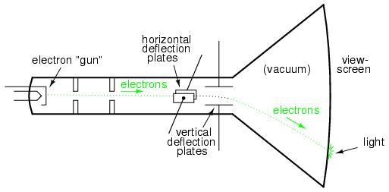
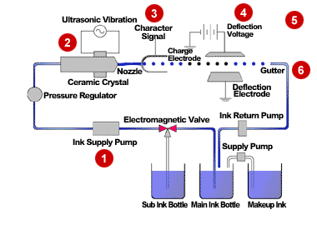
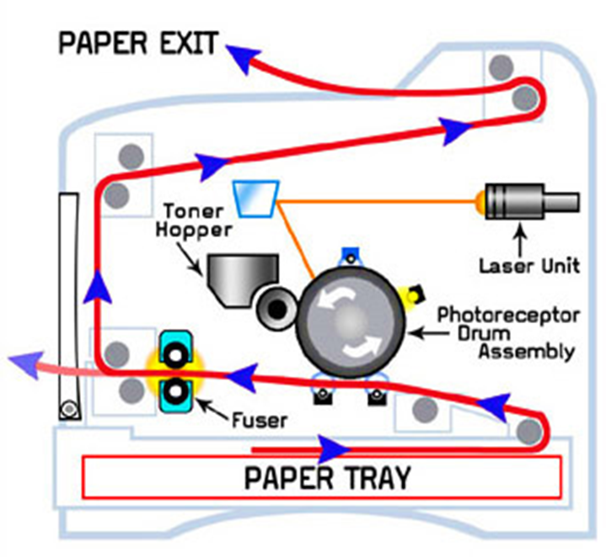
OUTPUT DEVICES:
MONITOR
An output device is any device used to send data from a computer to another device or user.
INKJET PRINTER
LASER PRINTER

Slide 7
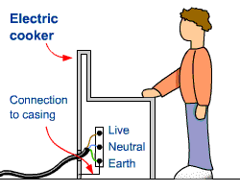
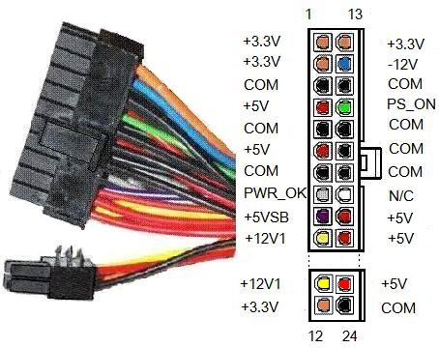
Switch Mode Power Supply(SMPS):
AC INPUT RECTIFIER AND FILTER
CHOPPER
STEP DOWN TRANSFORMER
DC OUTPUT
Dc
Dc wave
FEEDBACK
Earthing:
ATX connector

Slide 8
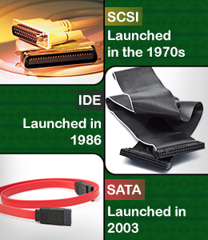
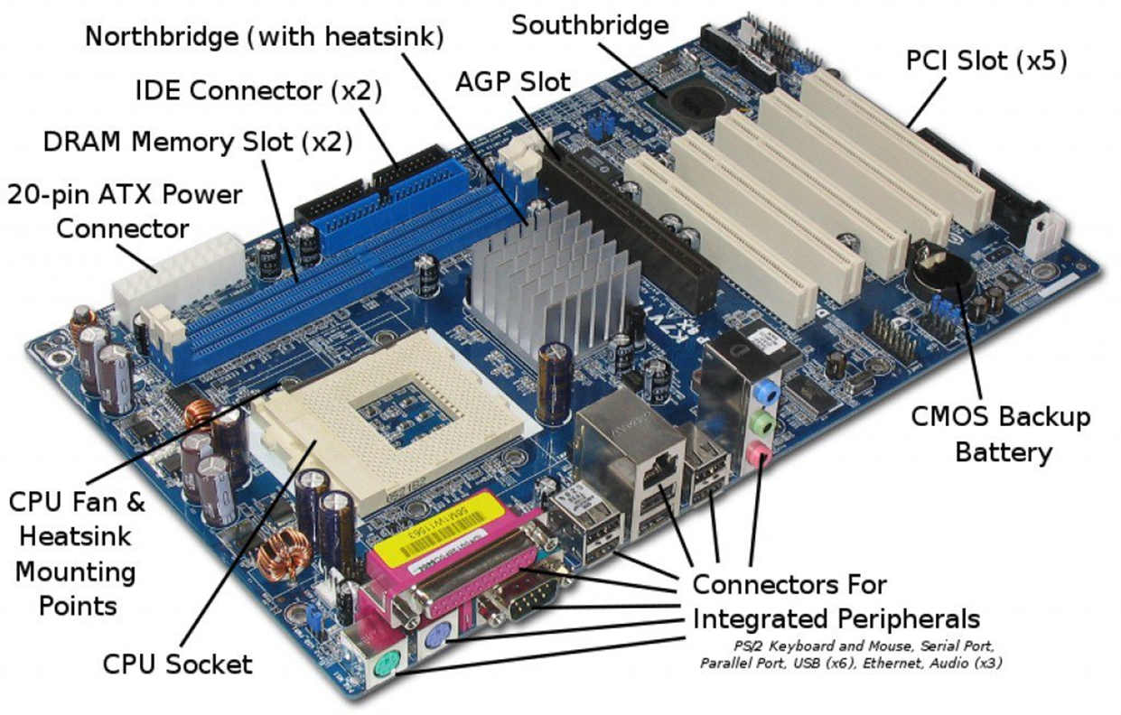
MOTHERBOARD

Slide 9
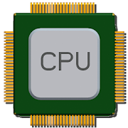
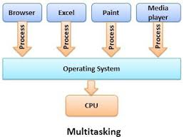
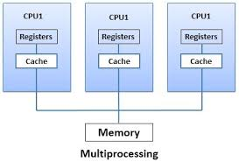
CPU ARCHITECTURE:
RISC
CISC
Simple
30-40 Instructions
One cycle
Parallel Execution
Multiple Register set
Complexity in compiler
Complex
100-200 Instructions
More cycles
Sequential Execution
Unique Register set
Complexity in CPU(micro-programming)

Slide 10
MEMORY
Memory is any physical device capable of storing information temporarily or permanently.
Memory
Primary Memory
Secondary Memory
RAM
ROM
Magnetic storage
Optical storage
PROM
EPROM
EEPROM
SRAM
DRAM
Hard disk
Magnetic tapes
CD
DVD
L1 Cache
L2 Cache
L3 Cache
DDR1
DDR2
DDR3

Slide 11
WINDOWS FUNDAMENTALS

Slide 12
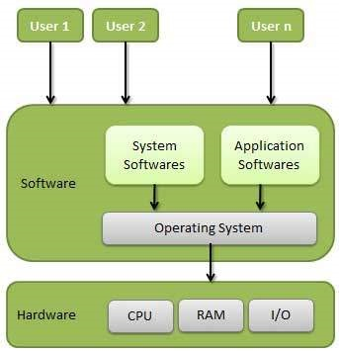
Operating system
It is an interface between user and hardware
Application
UI/Core
System Services
System Library
Device Drivers
Kernal
BIOS
Hardware Abstraction Layer
Hardware

Slide 13
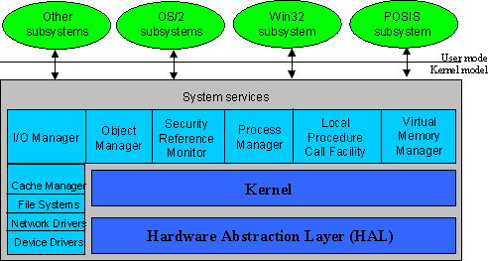
Kernel Architecture

Slide 14
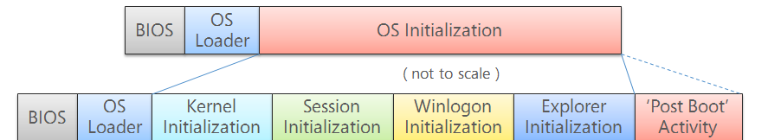
Booting Process

Slide 15
FILE SYSTEM
File:
File System:
Layout of File Allocation Table (FAT)
Partition Boot Record
FAT1
FAT2 duplicate
Root Folder
All Files
Layout of New Technology File System (NTFS)
Partition Boot Record
Master File Table
System File Data
File Area

Slide 16
PROCESS MANAGEMENT
Process Id
Attributes of a Process:
schedule
Process States:
Program counter
New
created
Ready
Running
completed
Termination
Process state
Priority
time quantum
Priority
I/O completed
I/O request
resume
suspend
General purpose registers
Wait
SuspendReady
List of open files
resume
suspend
List of open devices
Protection
Suspend Wait
Process completed I/O
but still in suspend

Slide 17
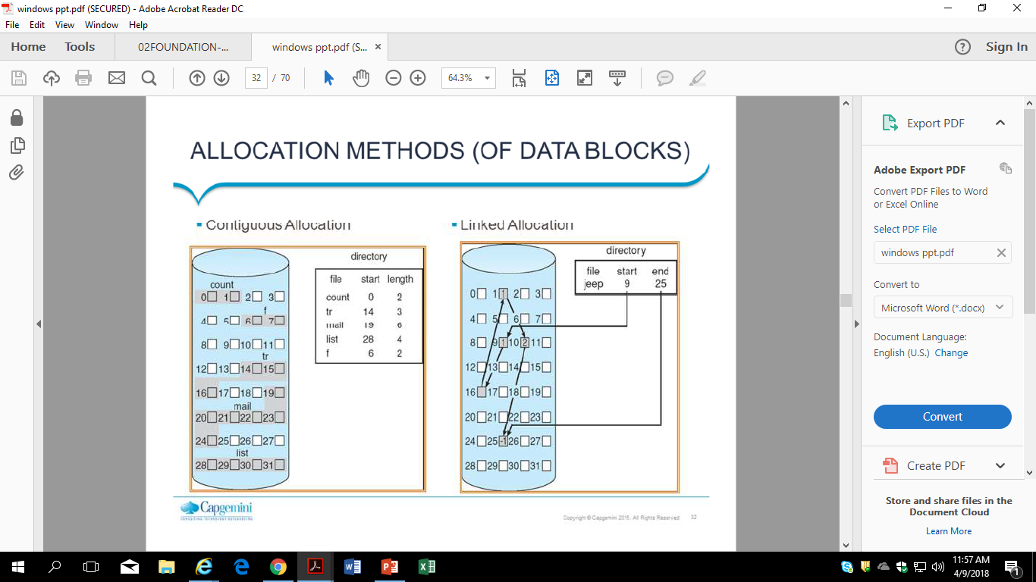
MEMORY MANAGEMENT
Continuous Memory Allocation
Linked Memory Allocation

Slide 18
Limit
Register
Relocation
Register
I 1
.
.
.
.
.
I 100
Logical
Address
Physical
Address
<
Main
Memory
CPU
Yes
+
trap
Continuous Memory Allocation

Slide 19
Paging Mechanism:
LOGICAL ADDRESS
PHYSICAL ADDRESS
PHYSICAL MEMORY
CPU
P | D
F | D
PAGE TABLE
P
P | F
P1 | F1
P2 | F2
P3 | F3
F

Slide 20
LINUX FUNDAMENTALS

Slide 21
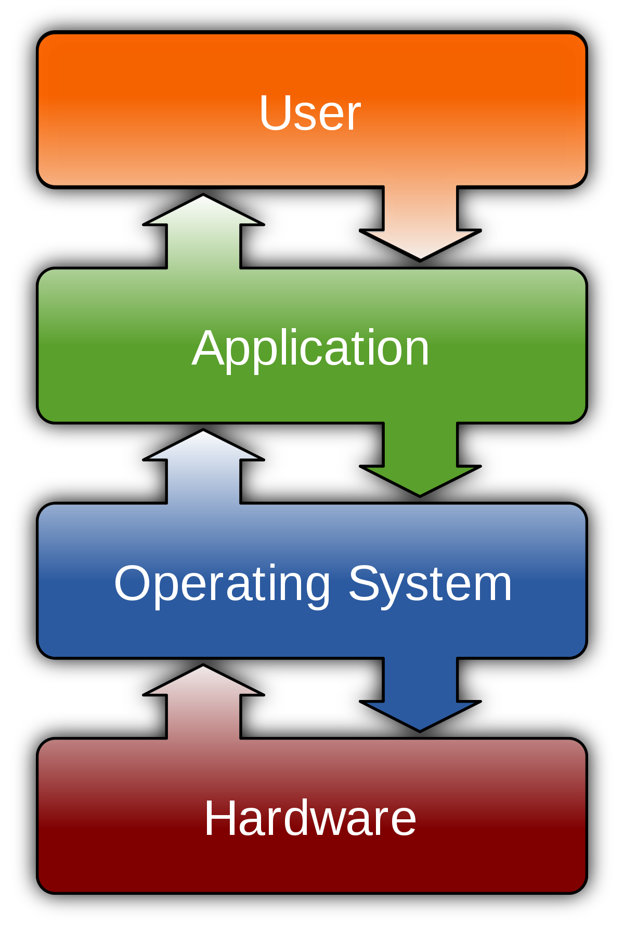



Operating System
An operating system is an integrated set of specialized programs used to manage overall resources and operations of the computer.
What if there is no operating system ?
Open Source License
GPL
ASL
MIT

Slide 22
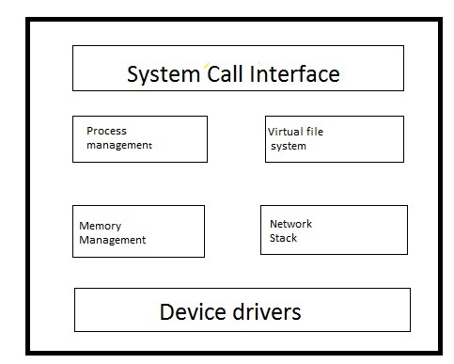

Booting Process
Kernel Subsystem
Linux kernel is composed of subsystems that communicate using procedure calls.
Booting is a start up sequence that starts the operating system of a computer when it is turned on.
BIOS
MBR
GRUB
KERNEL
INIT
RUN LEVEL
Power on
Login
INIT
/etc/inittab file to decide the Linux run level
Init identifies the default initlevel from /etc/inittab
RUNLEVEL
System executes the default runlevel
Executes /etc/rc.d/rc*.d/ programs
KERNEL
Mounts the root file system
executes the /sbin/init program
initrd is used by kernel as temporary root file system
MBR
Stands for Master Boot Record
Located in 1st sector of bootable device
Contains information of boot loader
GRUB
Stands for Grand Unified Bootloader
Stores the Kernel image
Located in /boot/grub/grub.conf
BIOS
Stands for Basic Input Output System
Performs POST method ( Power On Self Test)
Checks system integrity

Slide 23
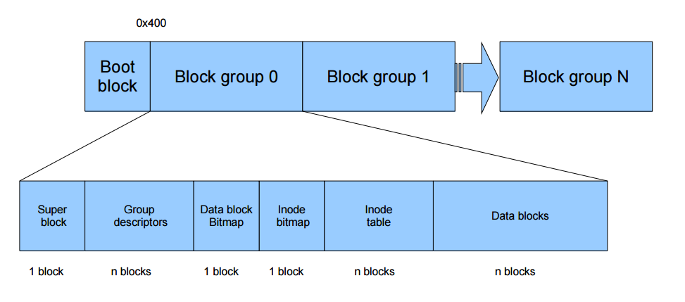
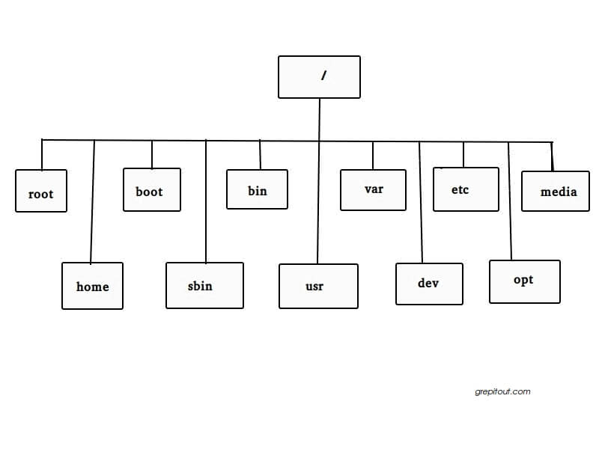
File System

Slide 24
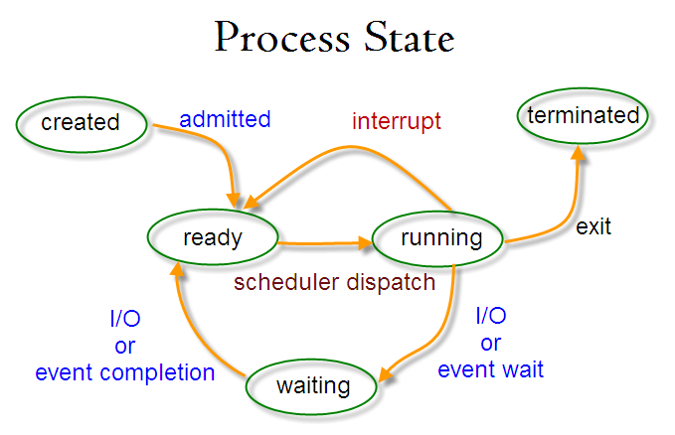
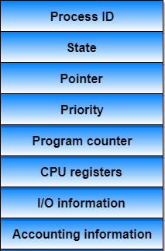

Process Scheduling
Process Management
Process scheduling is the activity of the process manager that handles the removal of the running process from the CPU and the selection of another process on the basis of a particular strategy.
Process is an instance of program execution
Types of Process
Process Control Block
Process States
Functions of Scheduler
Child Process
Daemon Process
Orphan Process
Zombie Process
Interactive Process
Batch Process
Real Time Process
CPU Utilization
Throughput
Turnaround Time
Waiting Time
Load Average
Response Time

Slide 25
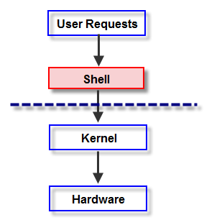

Shell
Shell is an environment in which we can run our commands, programs, and shell scripts.
It gathers input from you and executes programs based on that input.
Types of Shell:
ASH
BASH
KORN
T-SHELL
C-SHELL
Z-SHELL

Slide 26
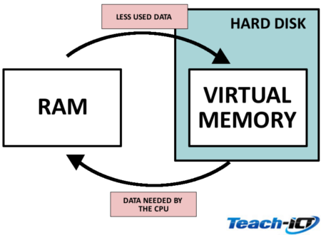
PROCESS OF PAGING
Memory Management
Memory management is the process of controlling and coordinating computer memory, assigning portions called blocks to various running programs to optimize overall system performance.
LOGICAL ADDRESS
PHYSICAL ADDRESS
PHYSICAL MEMORY
CPU
P | D
F | D
PAGE TABLE
P
P | F
P1 | F1
P2 | F2
P3 | F3
P4 | F4
P5 | F5
F

Slide 27
NETWORK FUNDAMENTALS

Slide 28
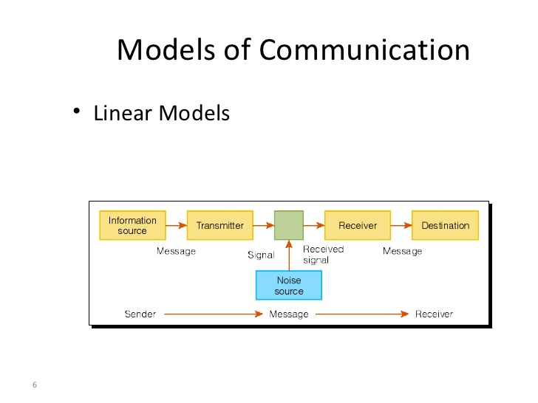
Communication
This is the process where the information is transmitted and in the other end the messages is received.
Components Of Communication
Network Characteristics
Fault Tolerance
Scalability
Quality of Service
Security

Slide 29
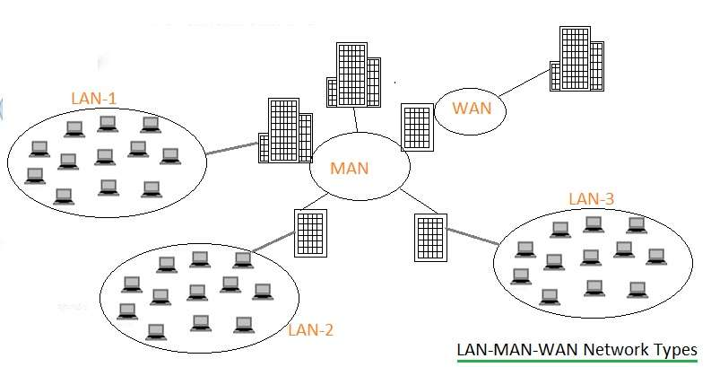
Network Types
LAN
MAN
WAN

Slide 30
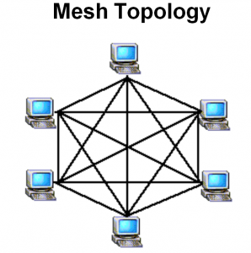
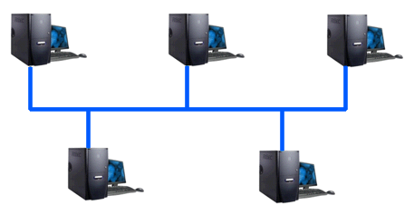

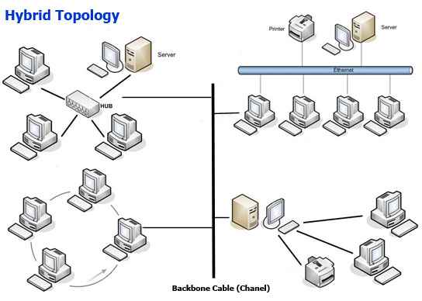
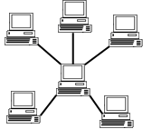
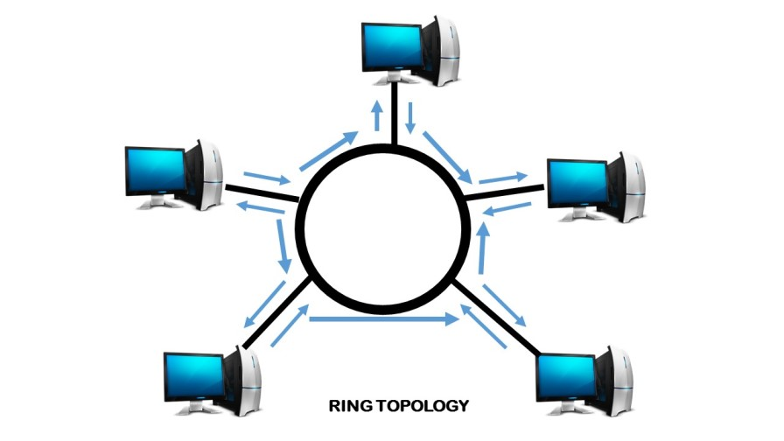
Network Topologies
Point–To-Point
Bus Topology
Mesh Topology
Star Topology
Ring Topology
Hybrid Topology

Slide 31
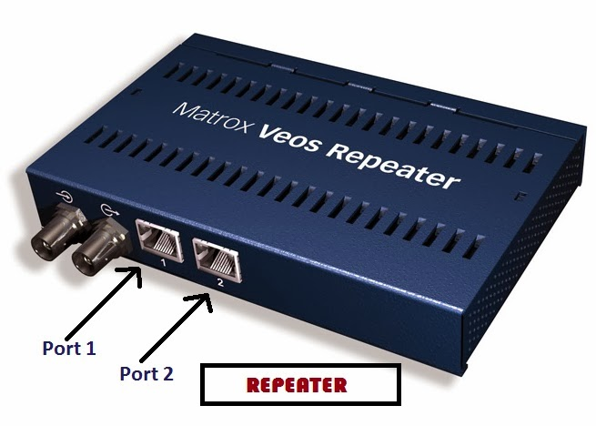
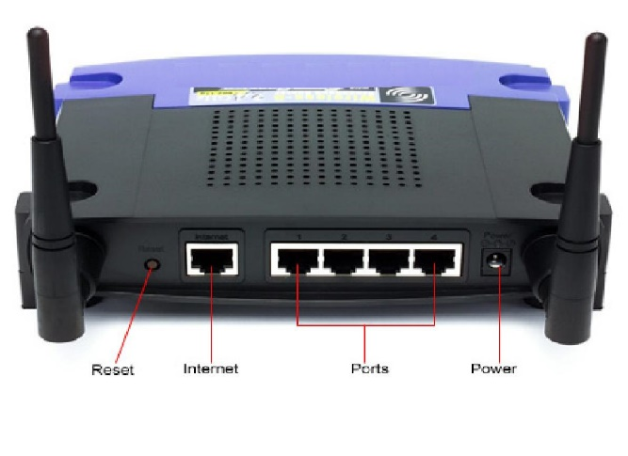
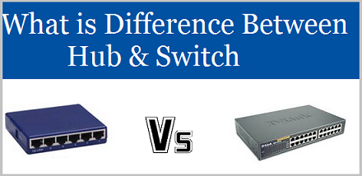
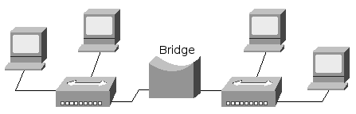
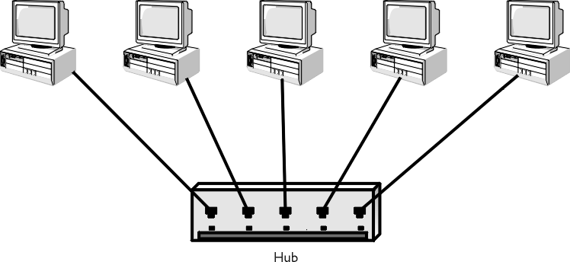
Network Devices
It is used to connect computers or other electronic devices together so that they can share files or resources.
Router
Switch
Repeater
Hub
Bridge

Slide 32
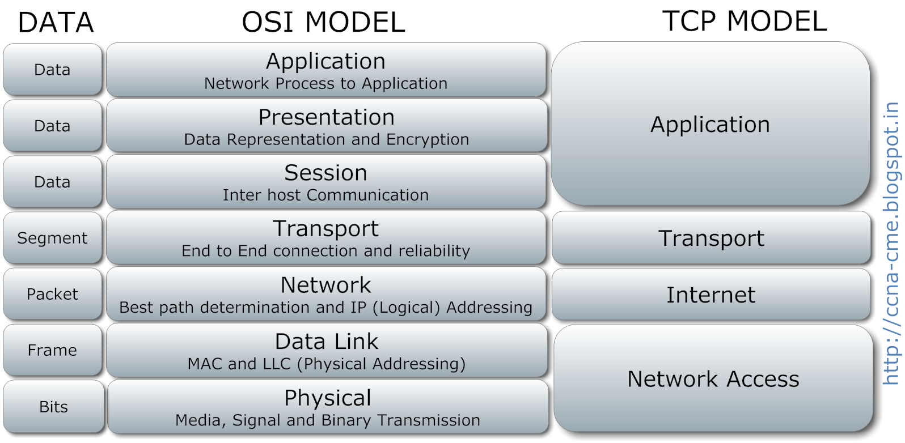
Complete OSI layer Protocol

Slide 33
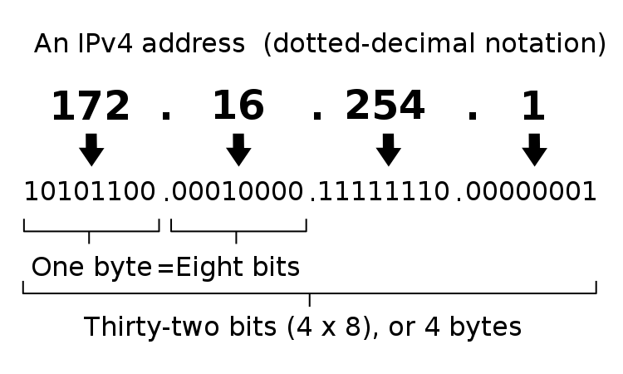
IP Addressing
An Internet Protocol address (IP address) is a numerical label assigned to each device connected to a computer network that uses the Internet Protocol for communication.
IPv4

Slide 34
IPv6
The 128 bit IPV6 address is written as Eight 16 bit integer.(Using decimal digits foe each integer)
Ex: CEDF : BF76 : 0000 : 0000 : 009E : FACE : 3025 : DF12
1100 1110 1101 1111 : 1011 1111 0111 0110 : 0000 0000 0000 0000 : 0000 0000 0000 0000 : 0000 0000 1001 1110 : 1111 1010 1100 1110 : 0011 0000 0010 0101 : 1101 1111 0001 0010
Abbreviations of leading Zeros:
CEDF : BF76 : 0 : 0 : 9E : FACE : 3025 : DF12
“ 0000 : 0000” can be written as “ :: ”
CEDF : BF76 : : 9E : FACE : 3025 : DF12
SLIDE NO: 23

Slide 35
Subnetting:
Subnetting is a way of splitting a network into smaller, more manageable pieces.
purpose of subnetting is to help relieve network congestion.
Reserved Address
Link-local Addresses
169.254.1.0 to 169.254.254.255
Loopback IP Addresses
127.0.0.1 to 127.255.255.254
Private IP Address
10.0.0.0 to 10.255.255.255.
172.16.0.0 to 172.31.255.255.
192.168.0.0 to 192.168.255.255.

Slide 36
NETWORK SERVICES

Slide 37
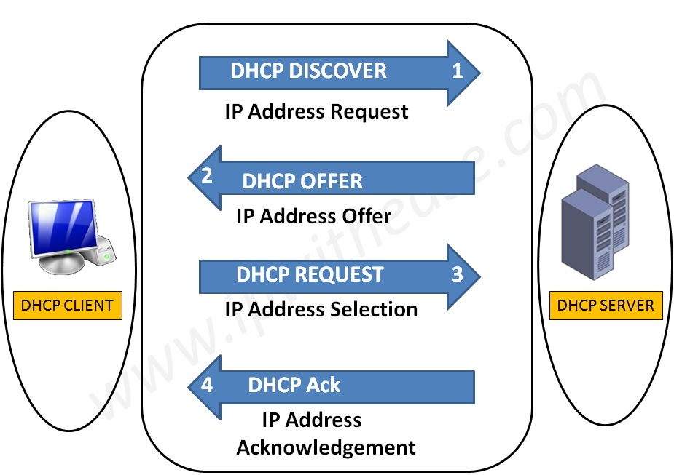
What is DHCP?
Logical Address
Used to dynamically assign an IP address to any node
DHCP Allocation Mechanism:
Manual allocation
Automatic allocation
Dynamic allocation
ARP
Physical Address
Logical Address
RARP
Physical Address

Slide 38
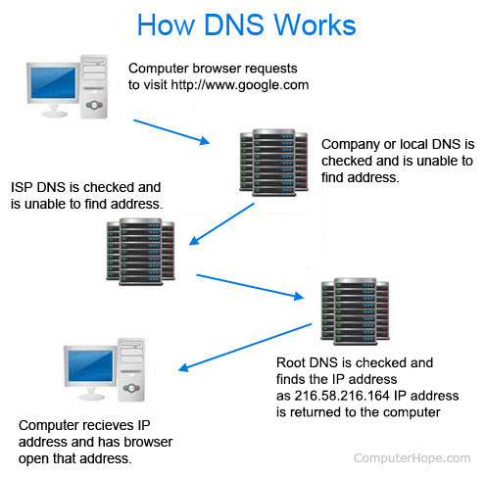
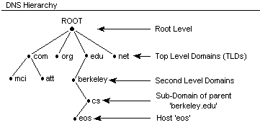
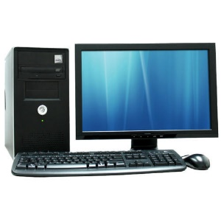
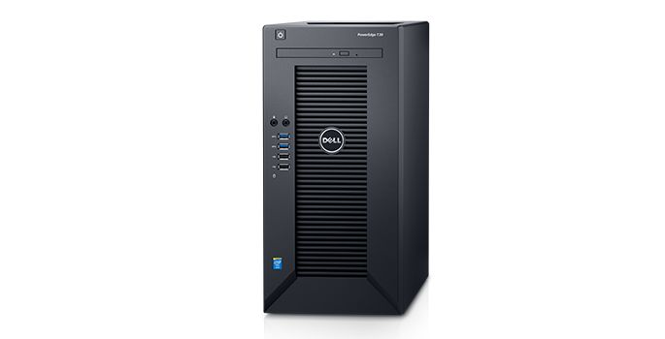

DNS
It converts a computer's host name into an IP address on the Internet.
What is ip of xyz.com
Client
Here is 156.x.x.x
Server
DNS CACHE
OS cache

Slide 39

LDAP (Lightweight Directory Access Protocol)
Lightweight Directory Access Protocol uses client-server architecture.
Directory services contain data and metadata.
X.500 formed the basis of a standard that is widely deployed known as LDAP.
ID | Name | Email
1 | John Doe | a@xyz.com
dc=org, dc=com
ou=finance
ou=eng
Cn=Sam Carter
Cn=Harry Milter

Slide 40



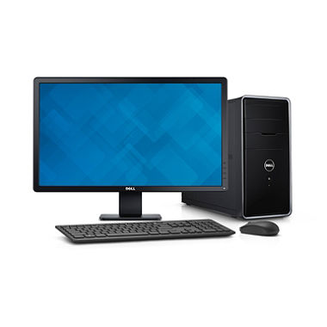

Mail Services
Mail Delivery Agent (MDA)
SMTP
SMTP
SMTP
Internet/Intranet
Mail Transfer Agent (MTA)
Mail Transfer Agent (MTA)
Pop / IMAP
Mail User Agent (MUA)
Mail User Agent (MUA)

Slide 41




Proxy Server
Proxy Caching
Acts as an intermediary between the user's computer and the Internet.
Forward and Reverse Proxy are two types of proxy server.
Proxy Server
www.abc.com
Document Request
Up to Date
Document sent from cache
www.abc.com
CLIENT
CLIENT
ISP
Remote Server
Proxy Server
CACHE

Slide 42
DATABASE FUNDAMENTALS

Slide 43
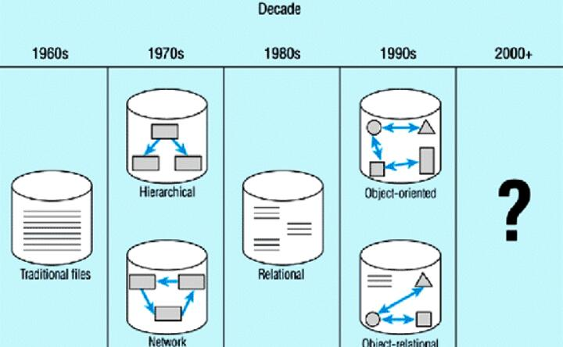
Database:
A database is a collection of information that is organized so that it can be easily accessed, managed and updated.

Slide 44
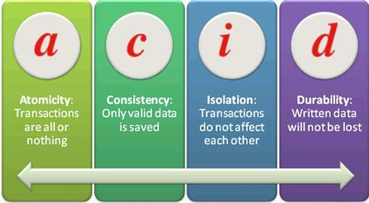
ACID PROPERTIES
Types of keys:
Primary key
Secondary key
Foreign key
Candidate key
Unique key
Composite key

Slide 45
EF Codd rules
Codd's rules refers to a set of 13 database management system rules (0-12) developed by E.F. Codd in 1969-1970.
He designed these rules as the prerequisites to consider a database management systems (DBMS) as a relational data base management system (RDBMS).
Although the rules were not initially widely popular in commercial use, later DBMSs were based on Codd's rules.

Slide 46
Terminologies
Attribute
EMPLOYEE
EMP_NUM | EMP_NAME | JOB_CLASS | CHG_HOUR
103 | June E Arbough | Elect. Engineer | 84.5
114 | Annelise Jones | Applications Designer | 48.1
118 | James J Frommer | General Support | 18.36
Cardinality=3
Tuple
Degree=4

Slide 47
Need of Normalization
Data anomaly
There are three types of Anomalies
1. Insert
2. Update
3. Delete
Functional Dependency
A-> B means for every value of A there is only one value of B.
Types of Functional Dependency
Fully Functional Dependency
Partially Functional Dependency
Transitive Dependency
PROJ_NUM | PROJ_NAME | EMP_NUM | EMP_NAME
15 | Evergreen | 103 | June E Arbough
 |  | 114 | Annelise Jones
18 | Amber Wave | 114 | Annelise Jones
 |  | 118 | James J Frommer

Slide 48
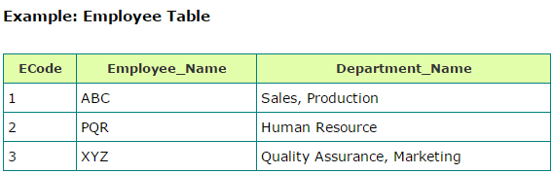
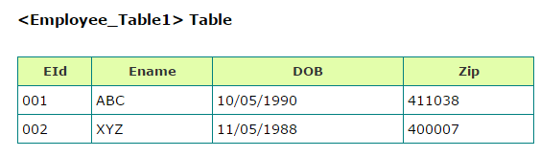


Normalization
Second Normal Form:
A relation is in Second Normal Form , If it is in First Normal Form and has no Partial Dependencies.
1 Normal Form: A relation is in First Normal Form if,
All data stored in the columns of the relation are atomic
No repeating Groups
Third Normal Form:
A relation is said to be in Third Normal Form , if it is in Second Normal Form and all Transitive Dependencies are removed.
Ecode | Employee_Name | Department_Name
1 | ABC | Sales
2 | PQR | Human Resource
3 | LMN | Marketing
Input
Output
Eid | Ename | DOB | Zip | City | State
001 | ABC | 10/05/1990 | 411038 | Pune | Maharastra
002 | XYZ | 11/05/1988 | 400007 | Mumbai | Maharastra
Multiple values
Ecode | Employee_Name
1 | ABC
2 | PQR
3 | LMN
Ecode | Department_Name
1 | Sales
2 | Human Resource
3 | Marketing
Atomic Values

Slide 49

SQL
Joins, Index, Views
Datatypes
Commands in sql

Slide 50
APPLICATION

Slide 51

Introduction
Application is a program designed to perform a group of coordinated functions, tasks, or activities for the benefit of the user
Components of Application
Life Cycle of Application
Presentation Layer
Presentation Logic
Business Processing Layer
Business Logic
Data Storage and Access
Data Persistence

Slide 52
Application
Application Types
API :
An application program interface (API) is code that allows two software programs to communicate with each other.
Compiled
Interpreted
REQUEST
Types of attacks:
SQL Injection
Cross site scripting
Denial of Service
Buffer Overflows
Session Hijacking
LARGE CORPORATE SITE/SYSTEM
SMARTPHONE APP OR WEBSITE
API
RESPONSE

Slide 53

Application
Architecture Types
Thick Client Architecture
Thin Client Architecture
Rich Internet Architecture

Slide 54
STORAGE

Slide 55


Storage Types
Fibre Channel is a high-speed network technology primarily used to connect computer data storage to servers.
Topologies:

Slide 56
NAS
SAN
DAS
Application
Client
Application
Application
File system
Network
File system
Network
File system
Disk Storage
Disk Storage
Disk Storage
NAS Server
RAID subsystem

Slide 57





RAID Level

Slide 58





Slide 59




RAID:
RAID storage uses multiple disks in order to provide fault tolerance, to improve overall performance, and to increase storage capacity in a system.

Slide 60
Thank You

